Slide 1
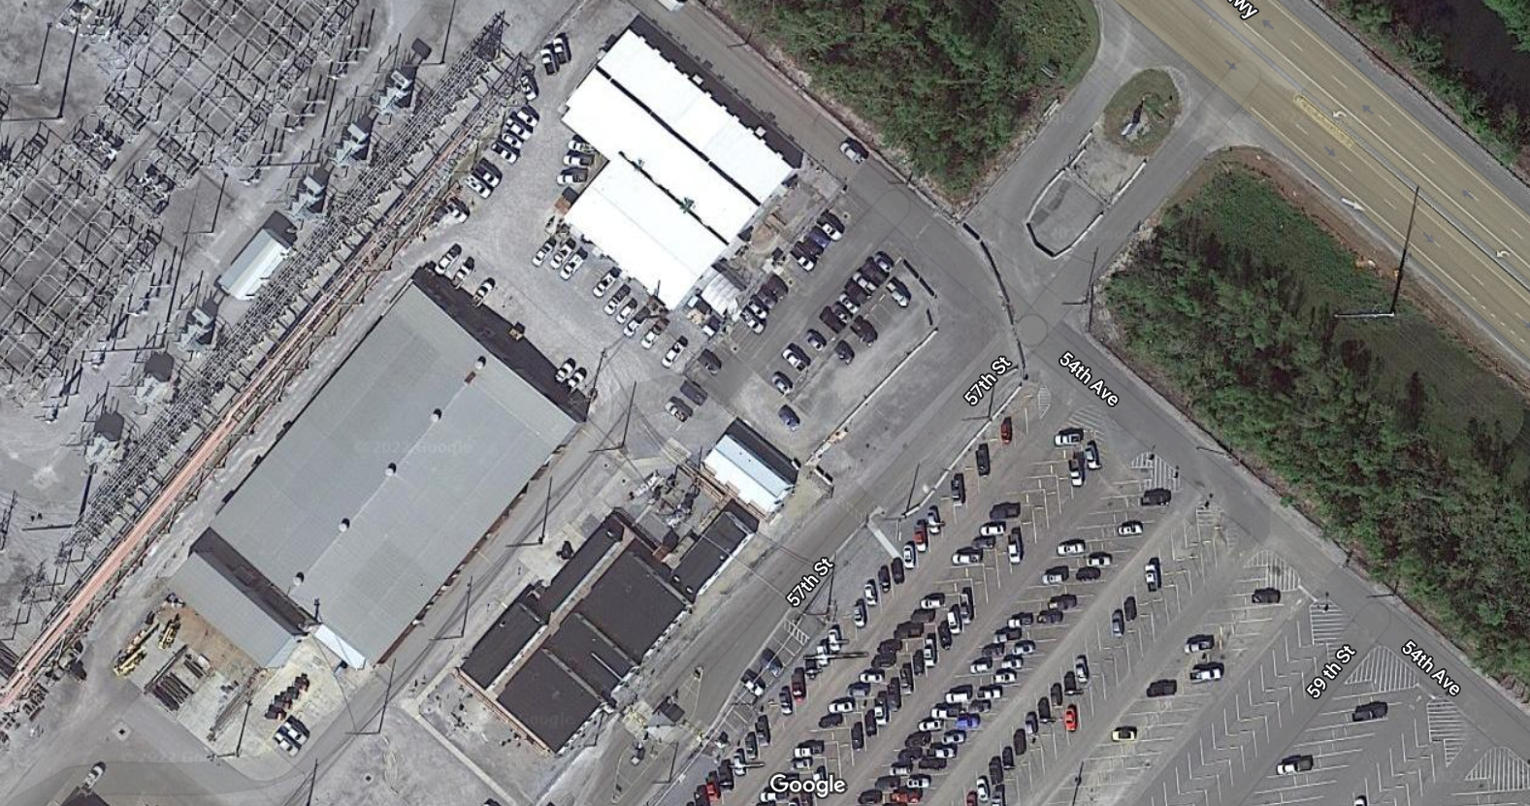
N
CSB
Contractor
Compound
Permit Vision
Training Room
CSA #6

